Slide 1


Amazon Web Services Influence in MPC
By Owen T, Sulman M, Donavan D, Bruce R

Slide 2
What is Amazon Web Services?
Amazon Web Services is a collection of tools built by Amazon that are utilized around the world by companies such as BMW, Coca-Cola, Epic games, and Netflix.
Example AWS Services:
Connect, Supply chain, EC2, CloudWatch, Elastic Beanstalk, Lambda

Slide 3
Why AWS?
AWS is a flexible solution to companies of all sizes with data and information needs
The services provided are especially useful to startups who may not have the capital to invest in infrastructure right away
Companies can scale their use of services as much or as little as they need with no upfront cost
A "modern utility company" where companies can use as many, or as little features as needed
It is one of the most reliable and secure cloud computing services with hidden data centers across the world

Slide 4
What is AWS Connect?
Customer service tool that uses cloud contact centers.
Allows for the collection of data on customer expectations and experience.
Improves worker productivity through seamless integration with ERP

Slide 5

What are some of the benefits to using AWS Connect?
Allows for a fluid implementation of forecasting, capacity planning, and scheduling tools.
Access to ML powered forecasting that accurately predicts and provides deep insights to assist in capacity planning and scheduling.
Uses machine learning built into AWS Connect to assist with Capacity Planning.
Estimate how many employees are required to meet customer support demands based on forecast.

Slide 6

What is AWS Supply Chain Optimization and its Benefits?
Connects your existing enterprise resource planning and supply chain management systems to AWS tools.
Allows communication across teams to quickly resolve issues that arise during manufacturing.
Lowers inventory cost by alleviating stock-out and overstock risks.
Automatically evaluates, ranks and produces various rebalancing options to provide inventory managers with choices if a risk occurred.

Slide 7
AWS EC2
Amazon Elastic Compute Cloud (Amazon EC2)
Compute platform (a data environment where software implementation occurs or a piece of software is executed)
Over 500 instances (Regions and Availability Zones)
Choice of the latest processor, storage, networking, operating system, and purchase model to match the needs of a workload
Supports Intel, AMD, and Arm processors
Only cloud with on-demand EC2 Mac instances and 400 Gbps Ethernet networking
Different uses include but are not limited to:
A business needing a computing infrastructure
Training and deploying machine learning applications
Notes:
The instances are made of multiple locations
Regions and Availability Zones
Regions consist of one more Availability Zones
By launching instances in multiple Availability Zones, you can protect your applications from the failure of a single location
Multiple choices of operating systems
Including Windows and Linux distributions
Arm processors are not as powerful as Intel but are more mobile-friendly in most cases.
400 Gbps is needed for machine learning
Pay for What You Use
It takes the cost of unused minutes and seconds in an hour off of the bill

Slide 8
AWS CloudWatch
Collects and visualizes real-time logs, metrics, and event data
Uses Automated dashboards to streamline the infrastructure and application maintenance
Different uses are but not limited to:
Understand and resolve the root cause of performance issues in your AWS resources
Find out exactly when your website is impacted and for how long
Notes:
Three main categories of logs:
Vended Logs
Natively published by AWS
Logs Published by AWS Services
Published by AWS Services
Custom Logs
Logs from your application and on-premises resources
Composite Alarms
Combine multiple alarms to reduce alarm noise.
Helps find the root cause to reduce application downtime
Lots of ways to monitor:
Logs and Metrics Correlation
Internet Monitor
Anomaly Detection
And more.
Ways to Analyze:
Monitor Trends and Seasonality with 15 months of metric data (storage and retention)
Lets you perform historical analysis
CloudWatch Metrics Insights
fast, flexible, SQL-based query engine that enables you to identify trends and patterns within millions of operational metrics in near real-time.
And more.

Slide 9
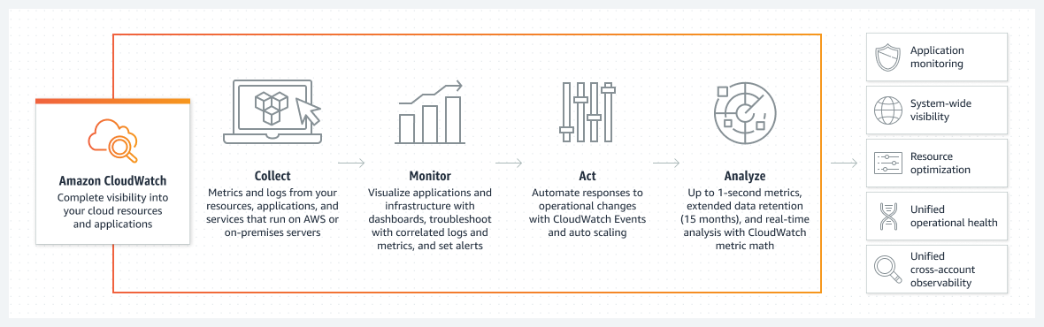
How the AWS CloudWatch Works

Slide 10
AWS Elastic Beanstalk
Service for deploying and scaling web applications and services
Upload the code, and Elastic Beanstalk automatically handles the deployment
from capacity provisioning, load balancing, and auto-scaling to application health monitoring

Slide 11
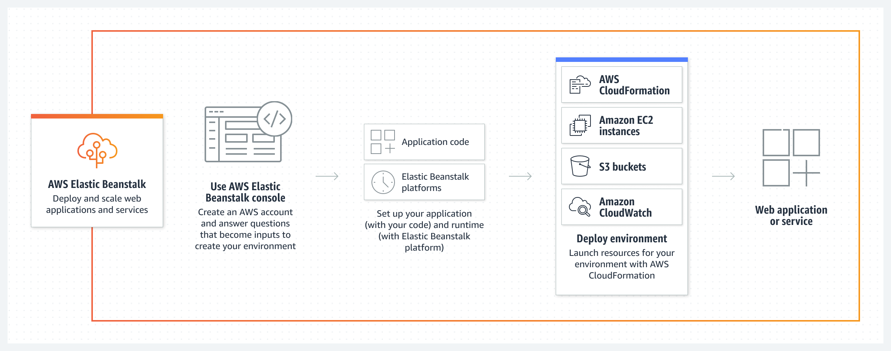
How the AWS Elastic Beanstalk Works

Slide 12
AWS Lambda
AWS Lambda is a serverless, event-driven computing service
Allows one to run code via a variety of applications/backend services
This can be done without the aid of provisioning and/or managing servers
There are 5 aspects to AWS Lambda
File Processing
Stream Processing
Web Application
IoT backends
Mobile Backends

Slide 13
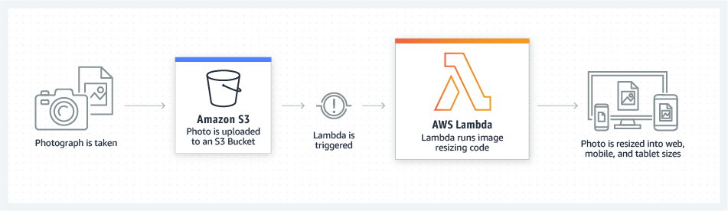
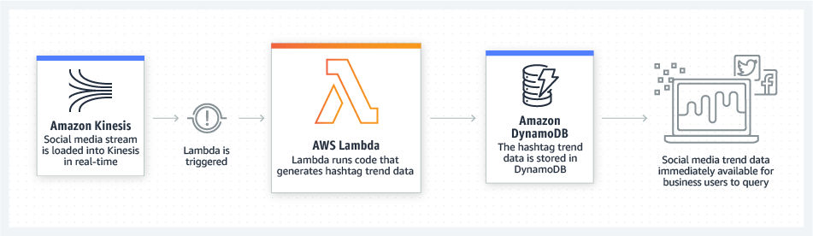
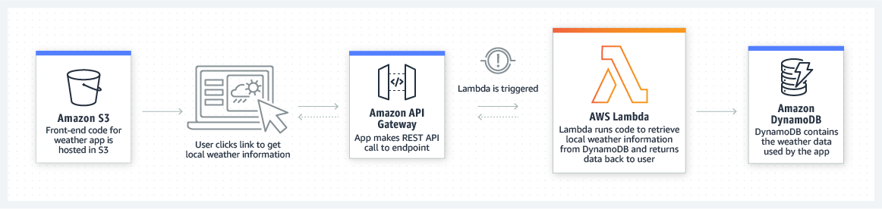
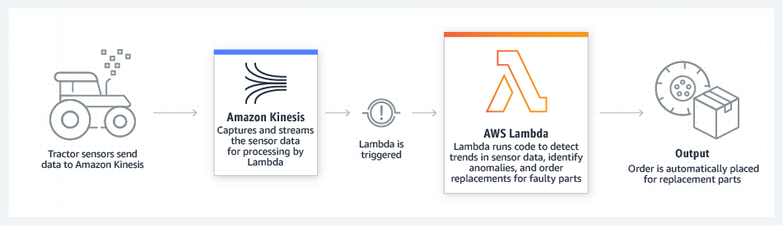
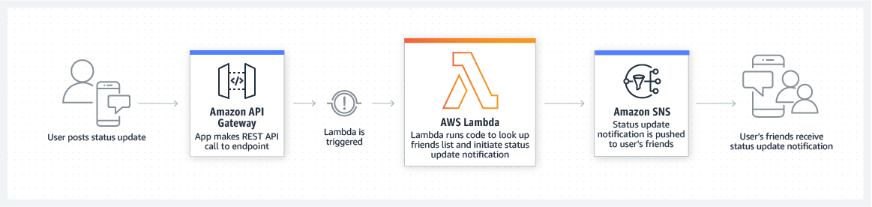
5 Aspects to AWS Lambda
File Processing
Stream Processing
Web Application
IoT backends
Mobile Backends

Slide 14
What are some of the benefits to using AWS Lambda?
Lambda is capable of scaling functions (or application) by running event triggered code as well as processing each individual event simultaneously, leading to "continuous scaling:
Using Lambda also frees up a large quantity of programming resources allowing a business to focus more on innovation and development

Slide 15



Case Studies
In 2019 Siemens used AWS Lambda and DynamoDB to reduce power plant alerts by 90%
Uses machine learning hosted on AWS SageMaker to help predict failures and update operators on optimal machine speeds and other variables
LG has thousands of employees throughout the world. Many employees work remotely so LG decided to use NICE DCV to decrease latency, increase resolution, and improve collaboration
In 2019 Volkswagen started moving 124 factories into a single architecture: The Volkswagen Industrial Cloud. They are also using machine learning to run algorithms and obtain information

Slide 16
Conclusion
Thanks to AWS, companies can see a wide range of benefits. Some of these include:
Lower IT/OT costs
By using web services, companies don't have to invest as much in infrastructure
Faster Innovation
AWS offers a wide suite of applications that can help companies solve problems quickly
Improved Operations
It is easy to store and organize data in AWS, and it is possible to run analytics in one place
Enhanced Security
Companies can be secure in knowing that AWS meets the most security-sensitive requirements for organizations

Slide 17

Questions?

